Slide 1


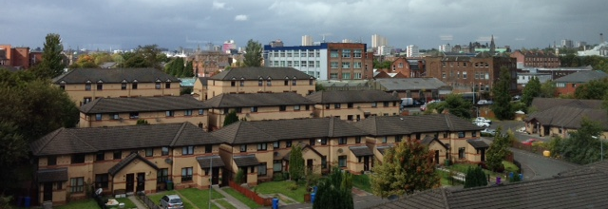
Belfast Healthy Cities Explorer Awards
Stephanie Thompson,
South Belfast Partnership Board
Glasgow – September 2015

Slide 2
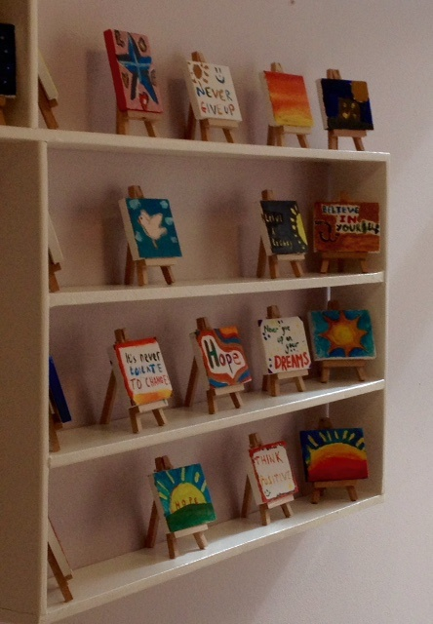
Purpose of the Explorer Visit to Glasgow
To explore and bring innovation and
inspiration back to Belfast to tackle health inequalities in local communities
An understanding of the public health structures in the city
Explore community and voluntary sector targeted programmes to tackle the use and misuse of drugs and alcohol in communities.

Slide 3
Northern Ireland Strategic Context
World Healthy Cities - Health 2020
New Strategic Direction for Drugs and Alcohol
DHSSPS Making Life Better Framework
DHSSPS Fit and Well Changing Lives
BSP Belfast Drug and Alcohol Coordinator Team (Northern Ireland Regional DACTs)

Slide 4
South Belfast Health Forum
Brings together over 80 members of the community, voluntary and statutory sector working towards addressing health inequalities in South Belfast
Vision :
‘To work towards a healthy and equitable South Belfast’
Thematic Priorities in South Belfast for 2015-2017:
    Emotional Wellbeing
    Physical Activity and Nutrition
    Addressing Isolation of Vulnerable Groups
    Use and Misuse of Alcohol and Drugs

Slide 5
South Belfast Context
The use and misuse of alcohol have impacted directly and indirectly on local communities,
hospital admissions, education, employment, domestic violence and deaths suspected to
be by suicide;
Mental Wellbeing
  49% of self harm presentations at hospital departments in Belfast were a result of drug overdose (2013)
  33% of self harm presentations at hospital departments in Belfast were a result of alcohol poisoning (2013)
Physical Wellbeing
  17 deaths recorded as drug related deaths in South Belfast in 2013
  15 deaths recorded as a result of alcohol related deaths in South Belfast in 2013
  53% of Drug Misuse in Northern Ireland has been recorded in the Belfast HSC Trust (2010)
Community Wellbeing
  45% of anti social behaviour incidents in South Belfast were drug or alcohol related (2013).
  28% of crime in South Belfast were drug and alcohol related (2013)

Slide 6

Healthy Cities Context
World Healthy Cities aims to develop a creative, supportive and motivating network to tackle health inequalities.
Belfast Healthy Cities through the explorer award bursaries wishes to promote solidarity and bring best practice and effective leadership back to Belfast to address health challenges in a collaborative way.
Contributions to the delivery of the Phase VI goals and core themes of Belfast Healthy Cities:
  Enabling the observation of leadership & participatory governance for health
  Provide direct access to WHO expertise in Glasgow to enable capacity and innovation to be brought to Belfast to be developed into pilot projects that will maximum partnership approaches.

Slide 7
Objectives of the study visit
Understand the public health structures in Glasgow
To evidence best practice joined up working and leadership opportunities
To evidence whole person approach programmes to tackle the use and misuse of drugs and alcohol in Glasgow
To appreciate how positive impacts and outcome are measured in another world healthy city

Slide 8
Strategic Drivers in Scotland
Changing Scotland's Relationship with Alcohol: A Framework for Action
Glasgow’s Road to Recovery
Glasgow’s Single Outcome Framework
Thriving Places Approach
Understanding Glasgow website
Glasgow Games Planning Toolkit

Slide 9
Health Structure in Glasgow
Glasgow’s Single Outcome Agreement (SOA) – 10 year formal agreement to target three priority areas:
  Alcohol
  Youth Employment
  Vulnerable people
Thriving Places approach – asset based approach
  ‘Doing with’ rather than ‘doing to’

Slide 10
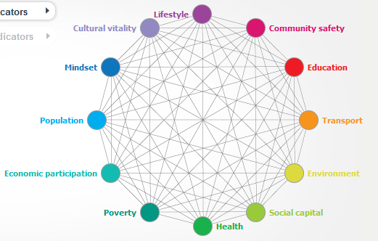
Glasgow Centre for Population Health
An organisation funded by Glasgow Council to work in partnership with Glasgow University and community groups
Role: Research and Development via pilot projects
Understanding Glasgow website

Slide 11
Glasgow Centre for Population Health
Glasgow Games Toolkit
What is it? Interactive way for a group to engage in a conversation
What do you need? Data that describes the current trends of the city and its people
Identify potential shocks to the system (e.g. a recession, welfare reform) and what the key concerns arising from these shocks would be
Link to: health, housing, transport, employment, mindset
Participants developed a declaration relating to each topic about how to address alcohol and drugs challenges in the city.
As a result, ‘the game’ provided 12 key recommendations to policy-makers about how to ensure the city can meet the upcoming challenges.

Slide 12


Glasgow Centre for Population Health
Managing Partnerships for Improving Health and
Wellbeing Research
Obstacles for successful partnerships:
  Culture clashes between agencies vs integration or co-location
  Confusion about roles – trust and terms of reference
  Staff Capacity – Support and sharing responsibility

Slide 13
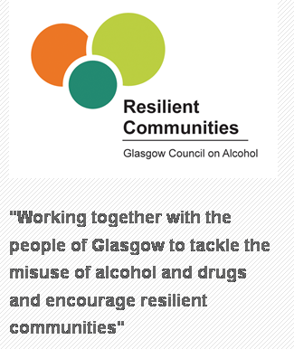
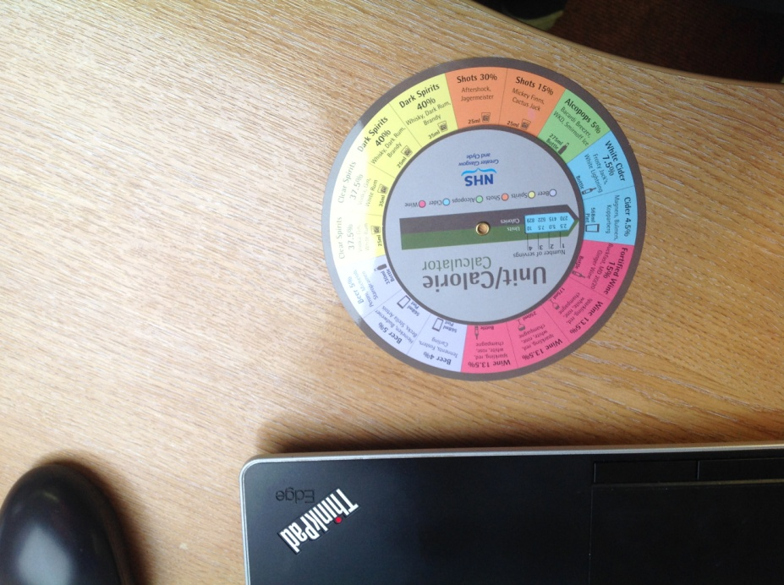
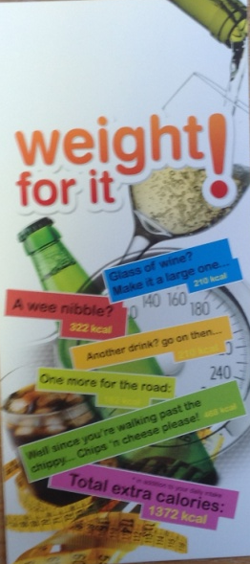

Glasgow on Alcohol
Prevention and education programmes
in Glasgow
Weight for it! Campaign for Adults
2015
  Clearer Choices Programme for Young People
  2015

Slide 14
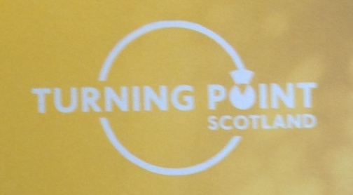
Turning Point Scotland:
South East Alternatives
Community Rehabilitation Clinic programme
Harm Reduction Model
Counselling, Support and Relaxation Space
Not Crisis Response – 4 days detox.
3 Phased programme:
  Phase 1: Sustaining Recovery Group Therapy; goal setting, routines and understanding commitment to change
  Phase 2: Smart Recovery Model - Employment and Education support;
  Phase 3: Steps to Excellence and Volunteering; understanding the impact the addiction has had on others; combined life coaching and CBT.

Slide 15
Turning Point Scotland
What is recovery?
Recovery is a process for individuals and communities
It is not a single event
It may take time to achieve and effort to maintain

Slide 16
Community Initiatives in Glasgow
Crisis Response Units in the Community
Bridgeton Community Learning Campus
Recovery Cafe Models

Slide 17
Turning Point Scotland –
Crisis Residential Care
Glasgow Homeless Service
Service users include: homeless, those sleeping rough or who have been experiencing a crisis through alcohol addiction
Person Centred Support Plan via MDT of professionals
Short term and long term (9-12) months resettlement programmes
Complimentary therapies are a necessity while using the service: socialising network, community garden on-site, alternative therapies including kinetic therapy support, art therapy

Slide 18
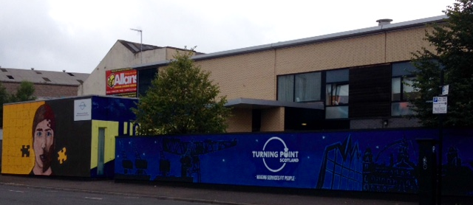
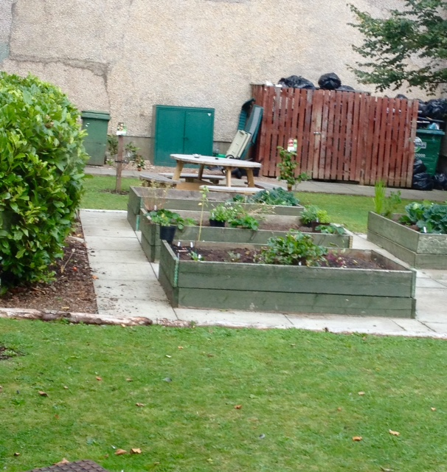
Turning Point Scotland – Crisis Residential Care
Community Residential Unit
Community Garden

Slide 19
Bridgeton Community Learning Campus
Providing centres in the community that make people feel safe
Multi functional community space
  Physiotherapy Drop In
  Community Chiropodists
  Health and Wellbeing classes
Service Users: general public, recovering addictions, recovery mental health clients who suffered self harm
Steps to Excellence 12 week programme model
Peer Facilitator classes
  Craft and Creations social enterprise
Community Achievement Awards with Glasgow Kelvin College

Slide 20
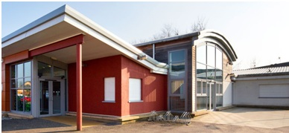
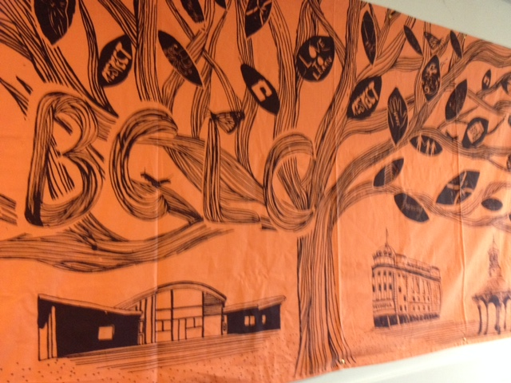
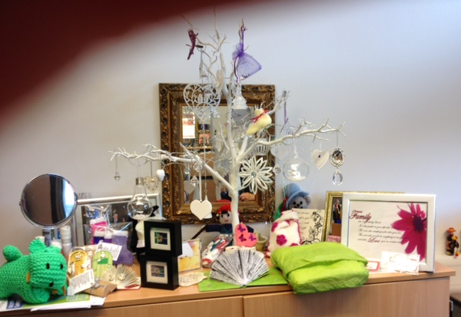
Bridgeton Community Learning Campus
Above:
Wall of Hope designed by service users in recover
To left:
Social Enterprise: Craft and Creations

Slide 21

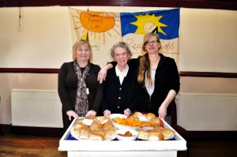

Recovery Cafes
Sunshine Recovery Cafe
Established in April 2014 by Renfrewshire Drug
and Alcohol Council
Based in a local church
Supports people in recovery from drug and alcohol addiction
Activities are run by volunteers who are in recovery
Grant funded activities include: cooking, music groups, homeless world cup
Training and development opportunities are available for volunteers; e.g. Food hygiene, health and safety, computing courses, book keeping
Other examples; Phoenix Futures
Notes:
Paisley, Renfrewshire

Slide 22
Setting up a recovery cafe
Representative from the Scottish Drugs Recovery Consortium – John White
Guide to developing a recovery cafe (2011)
Key elements of recovery communities are:
    Individual learning and development
    Reinforced by peer support and reprocity within helping relationships
    Overcoming deficit thinking and taking a positive participatory approach

Slide 23
Key Learning
Glasgow faces similar issues in terms of coordinating services in local areas to prevent duplication
Need for greater investment across the UK in recovery and re integration back into communities
Services should be tailored for every individual – person centred plans
Cities need to break down the stigma attached to addicts to enable recovery and belonging in the community
Successful partnerships are based on the need to create a sense of interdependence between organisations

Slide 24
South Belfast Drug and Alcohol Framework and Action Plan
Action Plan for 2016-2018
Partners: BDACT, Belfast Connections Team, South Belfast Health Forum and South Belfast PCSP
Priority 1: Prevention and Early Intervention
  Awareness Raising Education; with target groups on subject areas
  Information Sharing, Coordinated Campaigns for Belfast and Capacity Building through existing structures and groups
Priority 2: Reducing Supply and Demand
  Continue to promote locally the RAPID Removal Bins in South Belfast
  Regular feedback from information from the central DAMIS system
Priority 3: Empowering local communities
  Training Needs Analysis of community and voluntary sector
  Investment by PHA into the most appropriate workforce development model

Slide 25
Implementing the learning in Belfast
BSP – Belfast Drug and Alcohol Coordination Team: SB PCSP projects
Belfast Recovery Centre – Bradbury Centre – in 6 month pilot phase
Nightingale 24hr Centre - FASA - in operation
South Belfast SIF One Stop Youth Support Service – awaiting funding approval via OFMDFM
South Belfast Zen Garden – in development and seeking funding
South Belfast Recovery Cafe pilot project – April 2016 onwards
  Social Enterprise Model, Steps to Excellence Programme, peer support, group activities and health and wellbeing support service outreach

Slide 26

Questions

Slide 27
Contact Details
For further information or to discuss please contact:
Stephanie Thompson
Strategic Health Officer
South Belfast Partnership Board
Telephone: 02890 244 070
Email: stephanie.thompson@southbelfast.org

